Slide 1

TrafficTelligence: Advanced Traffic Volume Estimation with Machine Learning
TrafficTelligence is an advanced system that uses machine learning
algorithms to estimate and predict trafficvolume with precision.
By analyzing historical traffic data, weather patterns, events, and
other relevant factors, TrafficTelligence provides accurate forecasts
and insights to enhance traffic management, urban planning, and
commuter experiences.

Slide 2
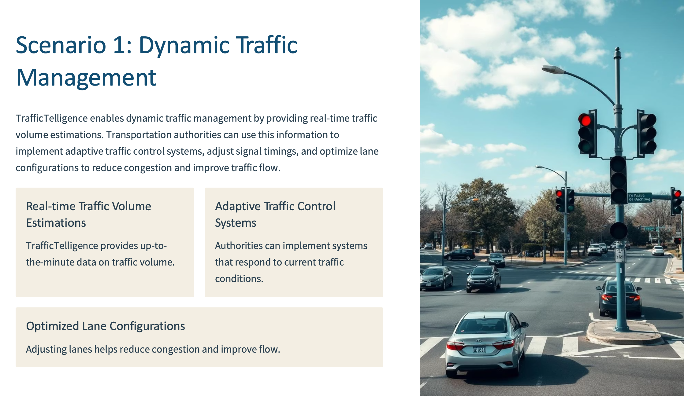

Slide 3
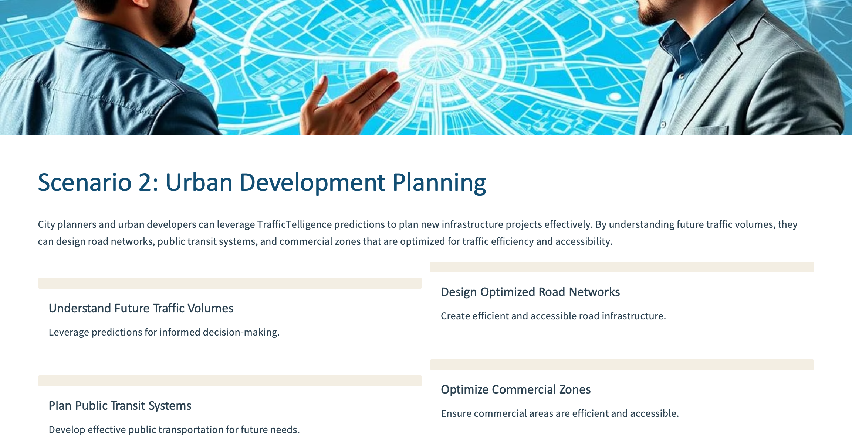

Slide 4
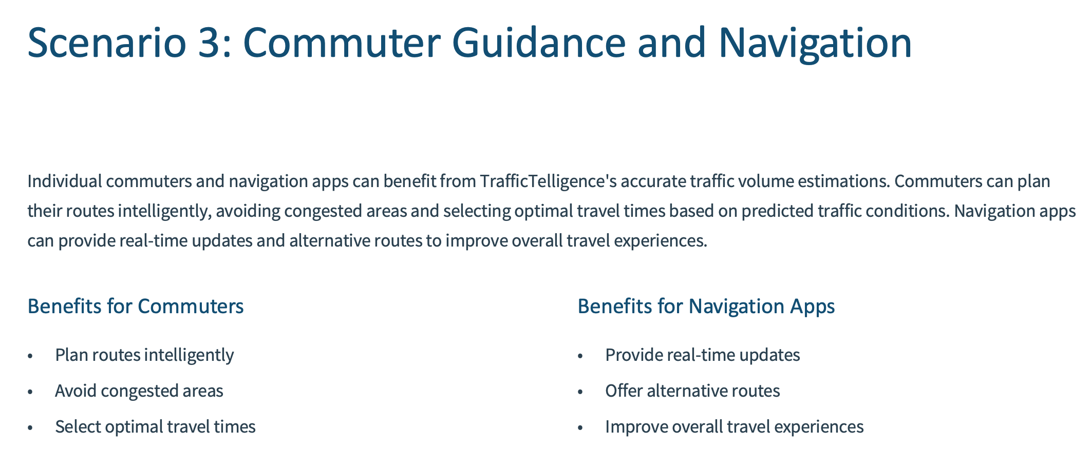

Slide 5
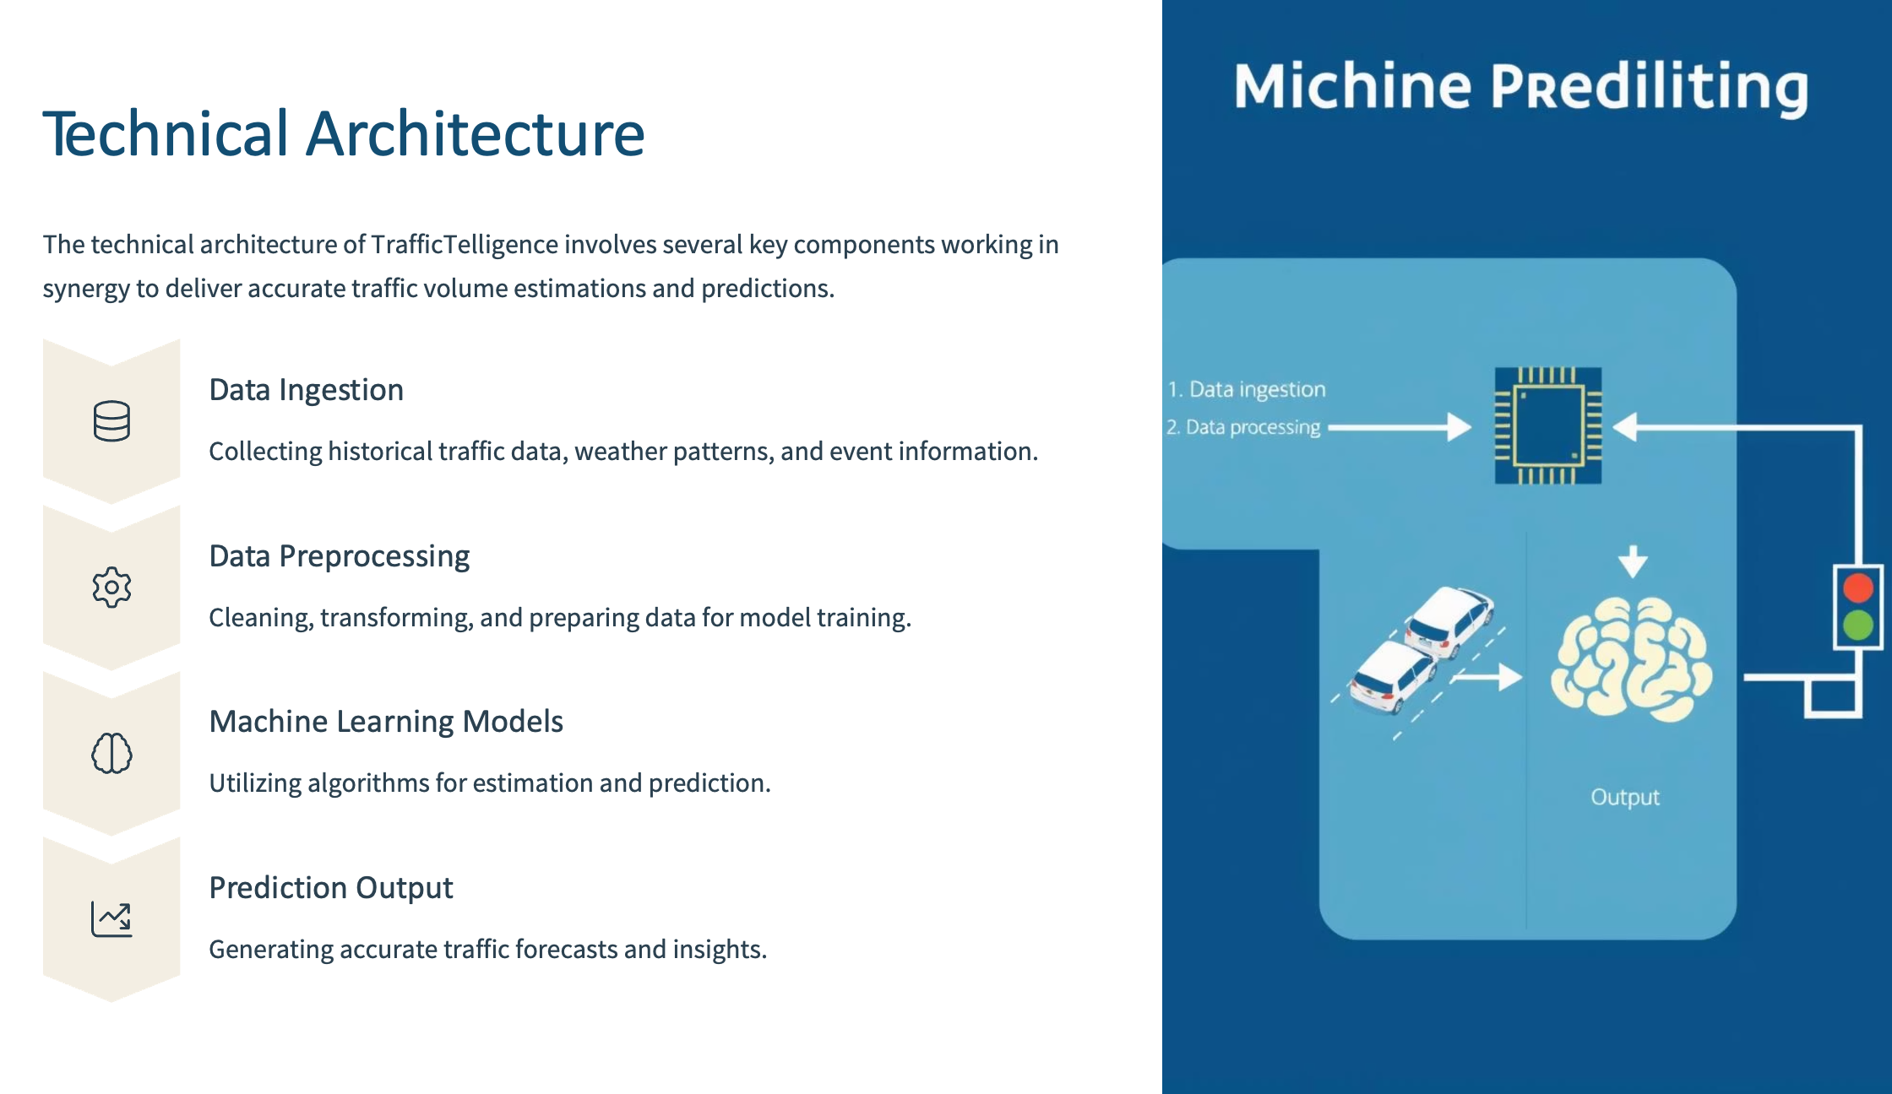

Slide 6
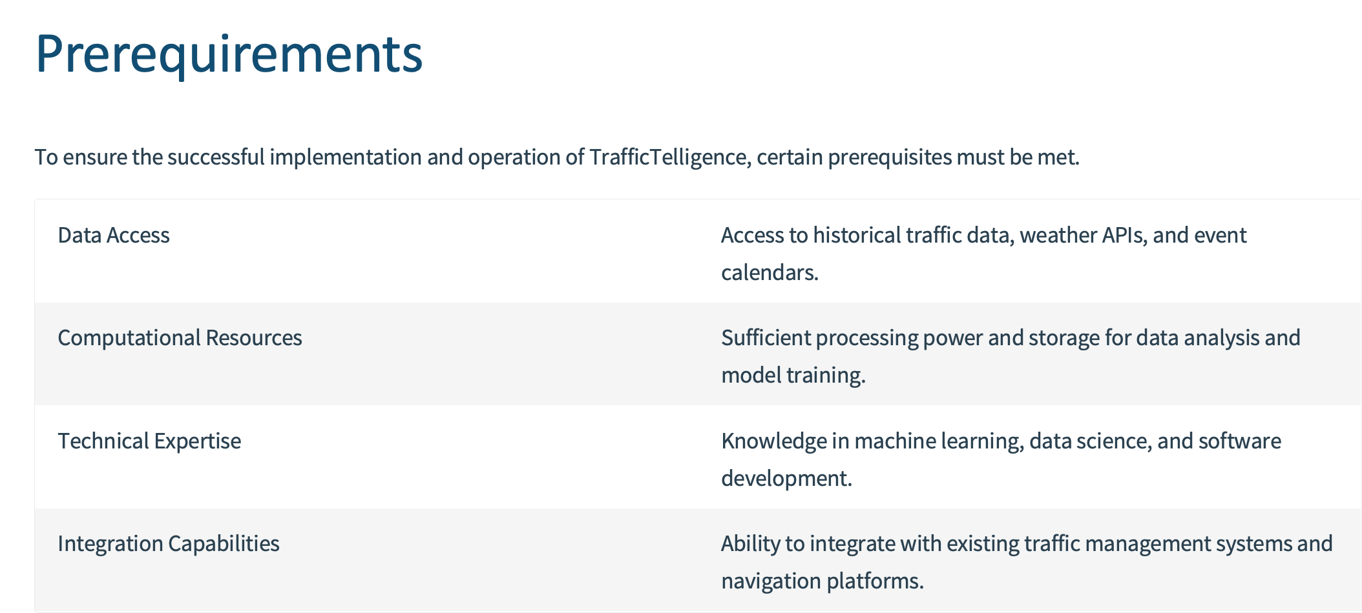

Slide 7
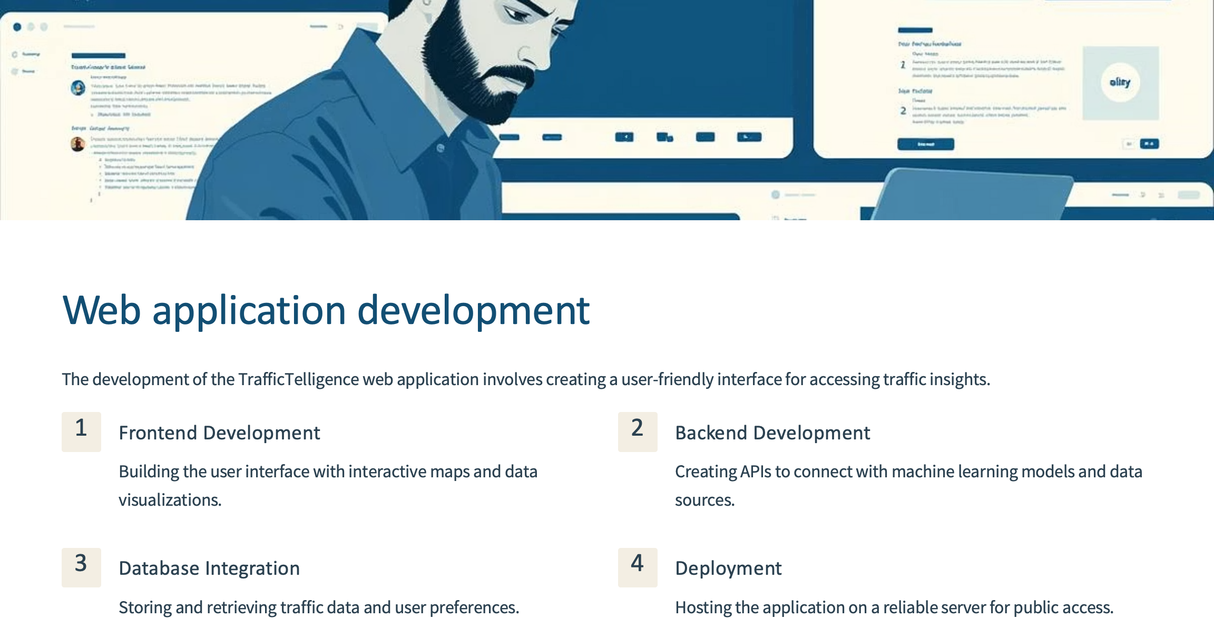

Slide 8
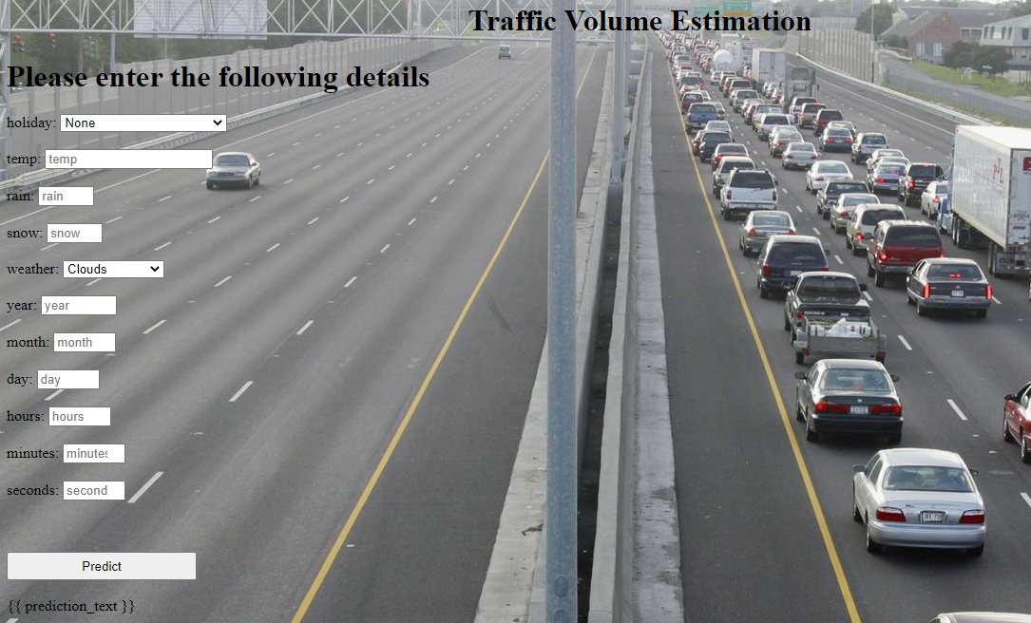
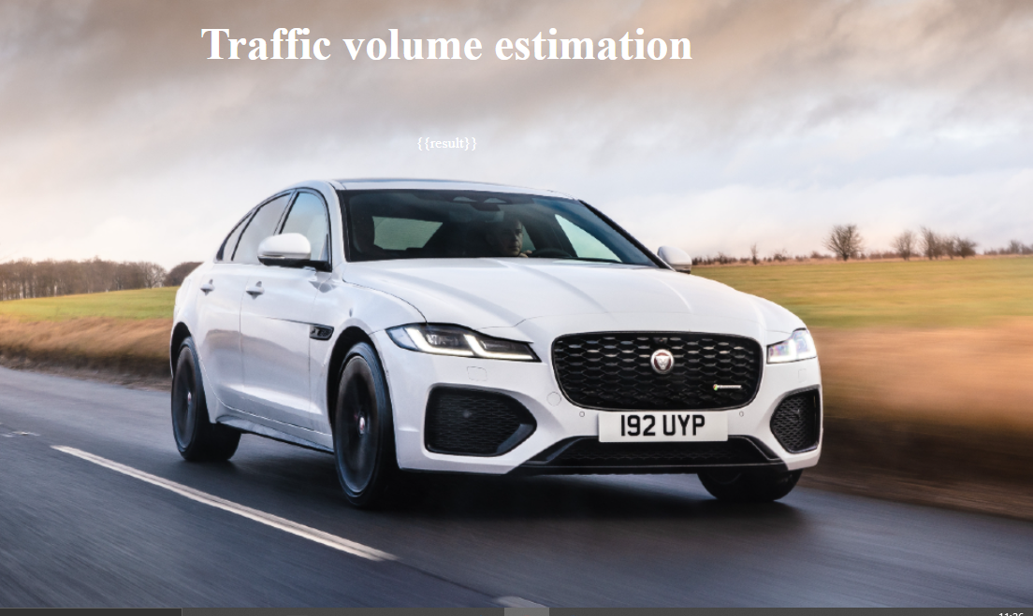
Web application landing page and output
2030

Slide 9
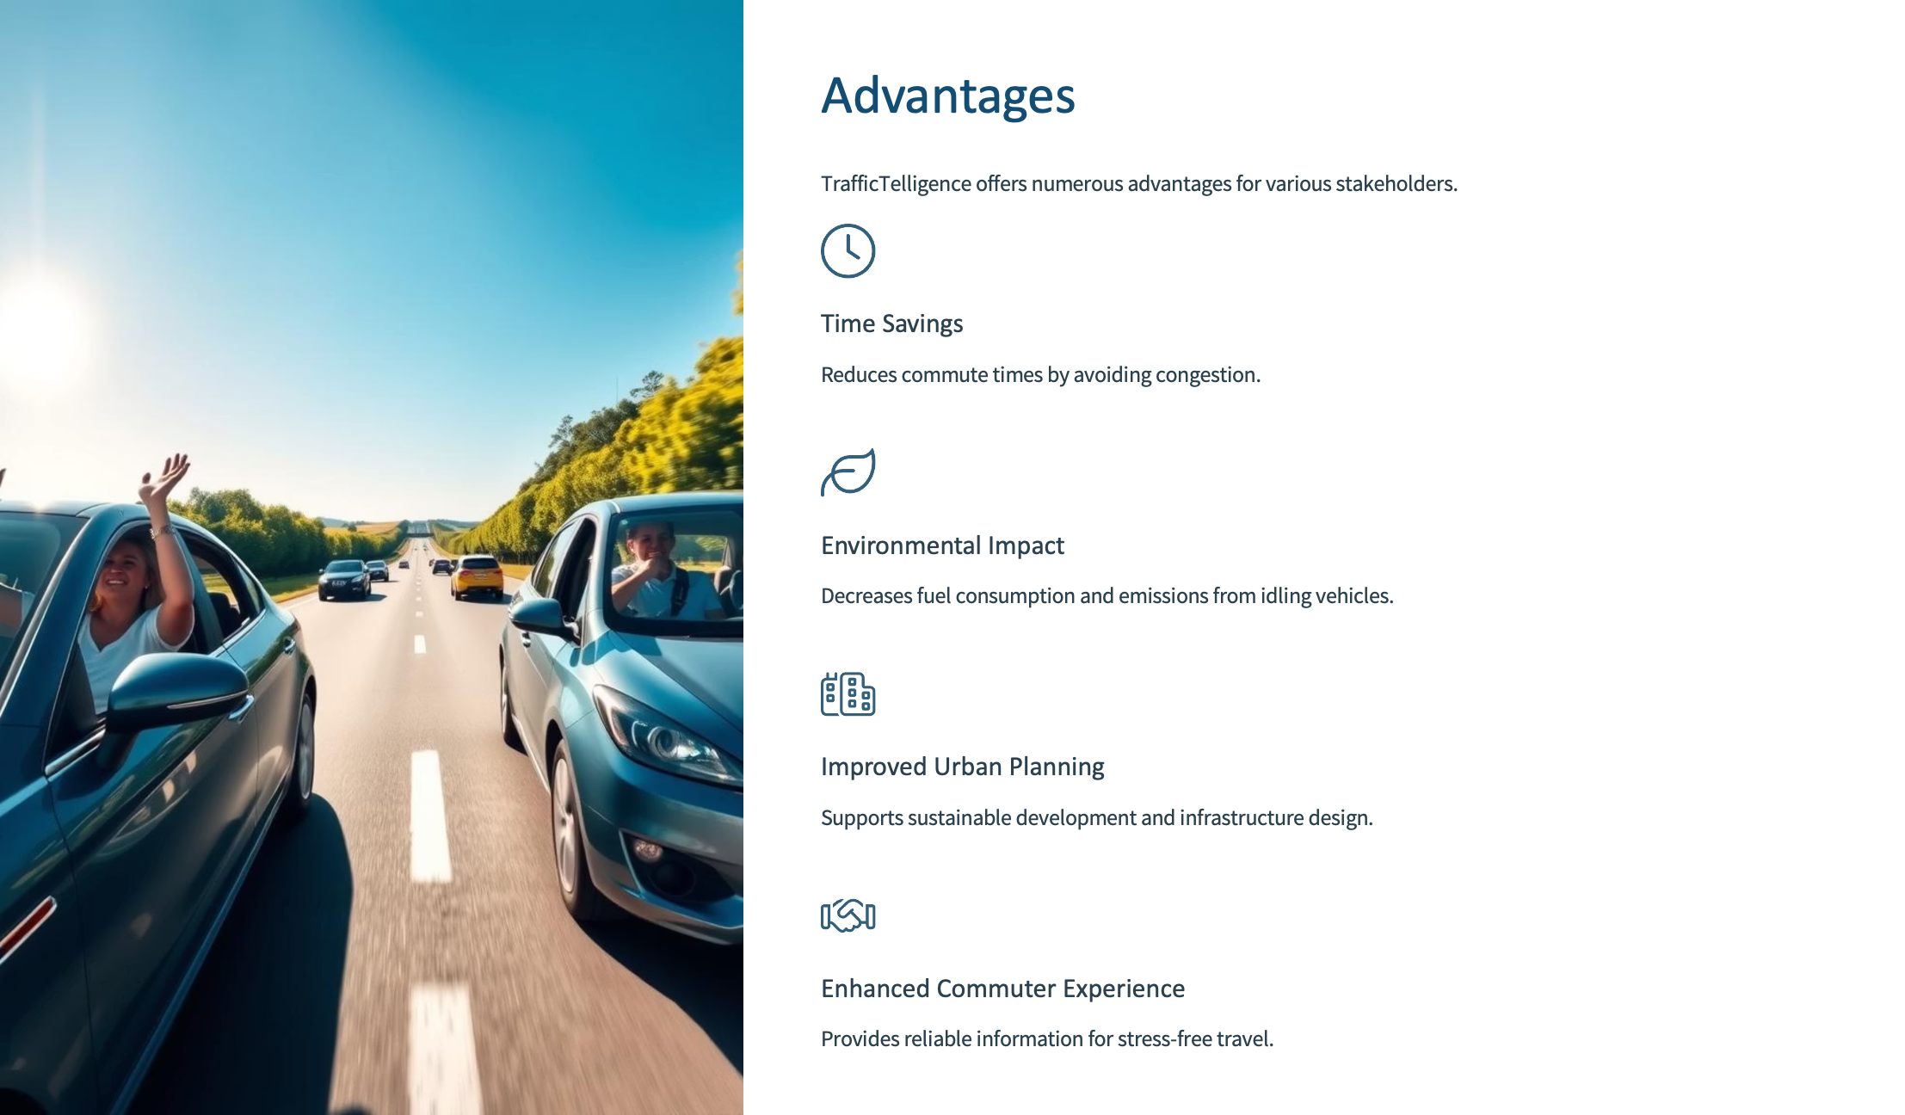

Slide 10

Conclusion
TrafficTelligence stands as a pivotal solution for modern traffic challenges, leveraging machine learning to deliver precise estimations and predictions. Its applications span dynamic traffic management, urban development planning,
and commuter guidance, promising a future of efficient and sustainable urban mobility.

Slide 11
Thank you

